Slide 1
Marketing

Slide 2
MARKET SEGMENTATION

Slide 3
Market segmentation is a process that consists of sectioning the target market into smaller groups that share similar characteristics, such as age, income, personality traits, behavior, interests, needs or location. It allows brands to create strategies for different types of consumers, depending on how they perceive the overall value of certain products and services.

Slide 4

Market Positioning
Market Positioning refers to the ability to influence consumer perception regarding a brand or product relative to competitors. The objective of market positioning is to establish the image or identity of a brand or product so that consumers perceive it in a certain way.

Slide 5
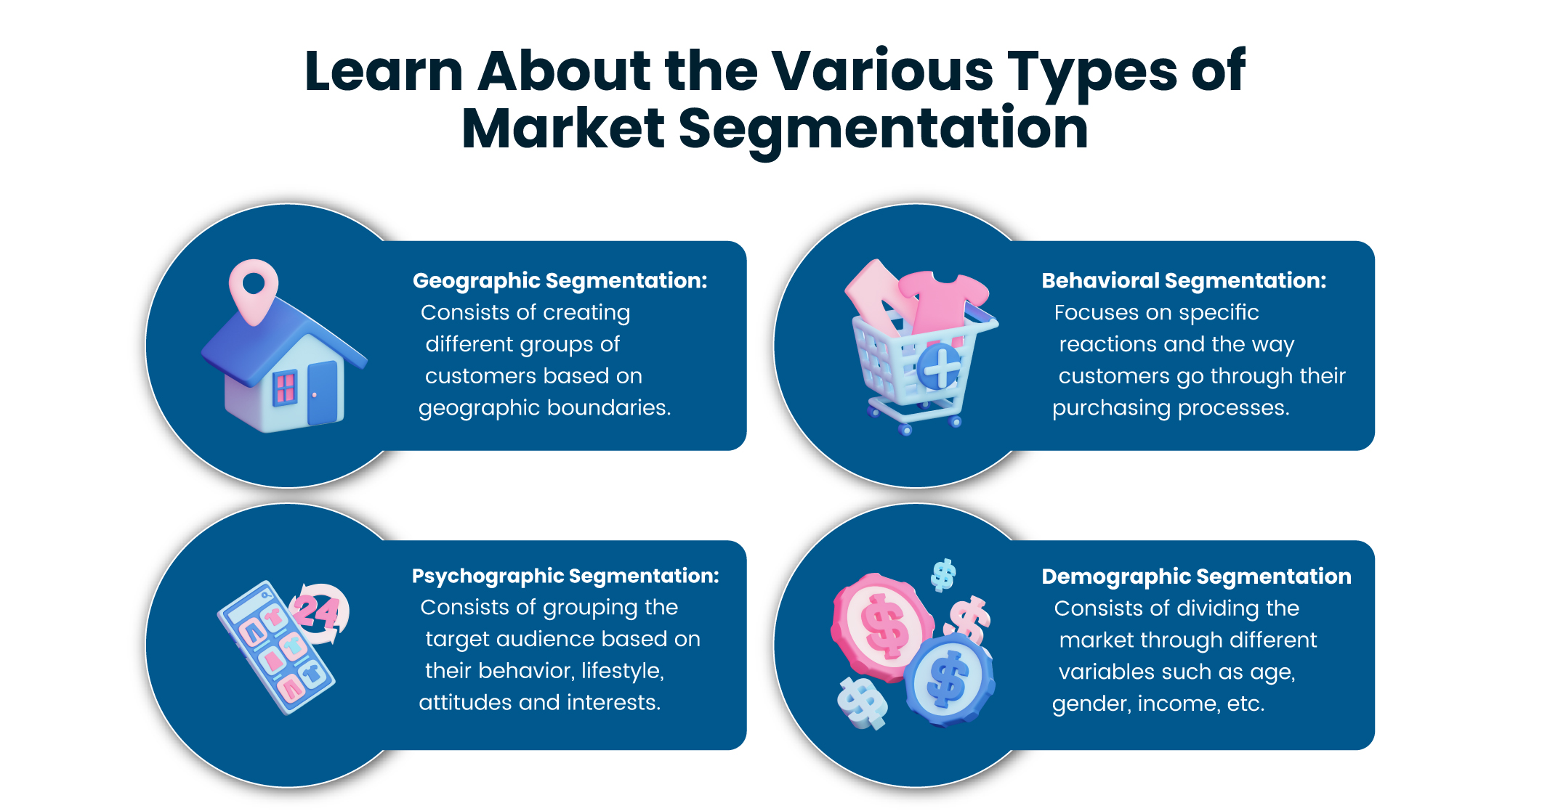

Slide 6
Geographic segmentation consists of creating different groups of customers based on geographic boundaries.
The needs and interests of potential customers vary according to their geographic location, climate and region, and understanding this allows you to determine where to sell and advertise a brand, as well as where to expand a business.
Demographic segmentation consists of dividing the market through different variables such as age, gender, nationality, education level, family size, occupation, income, etc.
This is one of the most widely used forms of market segmentation, since it is based on knowing how customers use your products and services and how much they are willing to pay for them.

Slide 7
Explanation
Psychographic segmentation consists of grouping the target audience based on their behavior, lifestyle, attitudes and interests.
To understand the target audience, market research methods such as focus groups, surveys, interviews and case studies can be successful in compiling this type of conclusion.
Behavioral segmentation focuses on specific reactions, i.e. the consumer behaviors, patterns and the way customers go through their decision-making and purchasing processes.
The attitudes the public has towards your brand, the way they use it and their awareness are examples of behavioral segmentation.

Slide 8
5 steps to implement a market segmentation strategy
Define your market: At this point of the segmentation you should focus on discovering how big the market is, where your brand fits and if your products have the capacity to solve what it promises
Segment your market: This step consists of choosing which of the types best suits your brand.
Understand your market: Ask your customers the right questions, depending on the type you chose. You must know your target audience in detail.
Build your customer segment: After collecting responses, you need to perform data analysis to create dynamic segments unique to your brand.
Test your strategy: Make sure you have correctly interpreted your survey data by testing it with your target audience. This will help you to revisit your market segmentation strategies and make the necessary changes.

Slide 9
Read the case & answer what helped Coca Cola the most in repositioning?
The example below describes Coca-Cola’s repositioning of Mother Energy Drinks: ‘The Coca-Cola Company’ launched Mother Energy Drinks in 2006 into the Australian market.
The launch campaign was professionally executed, and Coca-Cola was able to leverage its distribution channels to get the product into major retailers. However, the taste of Mother Energy Drink was subpar and repeat purchases were very low. Coca-Cola was faced with a decision: to improve and reposition the product or withdraw it and introduce a new brand and product. The company ultimately decided to reposition the product due to already high brand awareness.
The biggest challenge faced by Coca-Cola was to persuade consumers to try the product again. The company changed the packaging, increased the size of the can, and improved the taste of the product. The relaunch of the product featured a new phrase – “New Mother, tastes nothing like the old one. "Ultimately, Coca-Cola was able to successfully reposition Mother Energy Drinks and the brand today competes with the two leading energy drinks in the market –V and Red Bull.

